Slide 1
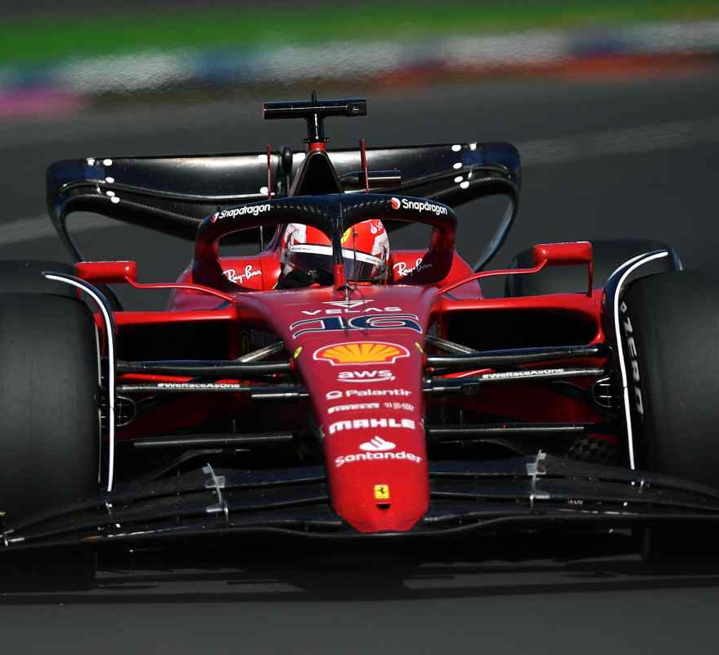
DRS OPTIMIZATION
Team members:
-Beber Luca
-Brocchieri Emanuele
-Saccani Nicola

Slide 2
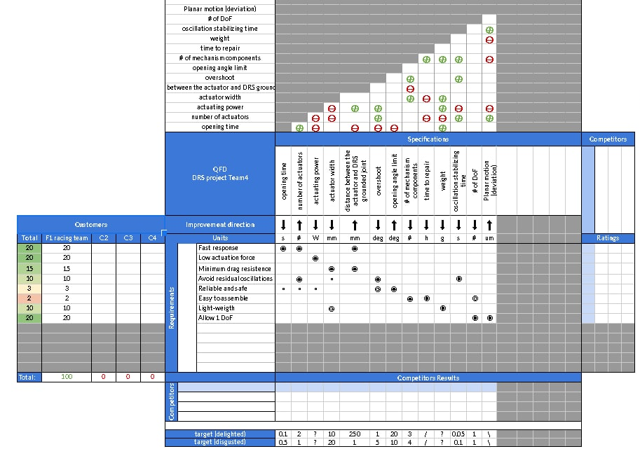
Quality Function Deployment

Slide 3
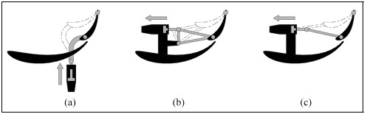
Three cases of study
a) Push-up type
b) Pod-rocker type
c) Pod-pull type

Slide 4
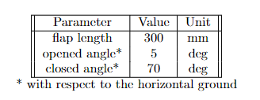
KINEMATIC ANALYSIS
Goals:
Derive the 2D kinematic model;
Address the initial position problem, position analysis and velocity analysis;
Compute the purely kinematic engineering specifications and performance indices;
Produce dimensional optimization.
Decisions:

Slide 5
Push-up type

Slide 6
Pod-rocker type

Slide 7
Pod-pull type

Slide 8
DYNAMIC ANALYSIS
Goals:
Derive a dynamic model of both the DRS mechanism and the actuating hydraulic system;
Perform some analysis to evaluate the system performance;
Compare the dynamics numerical solution with Maple solver;
Perform a dynamics-based optimization.
asdasd:

